Slide 1
Global Economic Crisis

Slide 2
Introduction
The U.S. and the global economy have been – and continue to be – in serious crisis, and the current global recession is the worst economic downturn since the Great Depression of the early twentieth century
The Dow Jones plunged more than 50 percent from its highs of 14,000 in late 2007 to below 6,500 in early 2009, with more than a trillion dollars of value lost in the stock market in little over a year
Although the Dow rose to around 12,500 a little over two years after its worst decline,the recent turmoil on Wall Street over the past two weeks, which pushed the Dow down to the the 10,000 level could make things worse – a “double-dip recession” turning into a depression

Slide 3
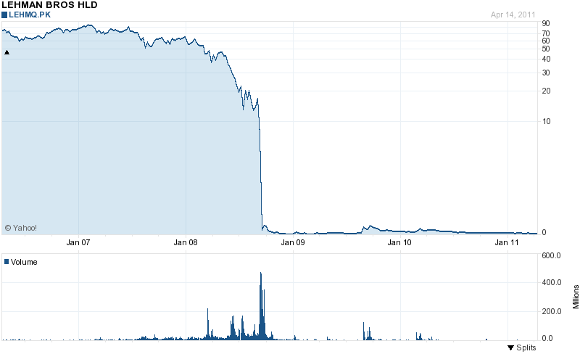

Slide 4
Origins of the Crisis
The periodic crises resulting from the capitalist business cycle now unfolds at the global level
The current crisis of the world economy is an outcome of the consolidation of economic power that the globalization of capital has secured for the transnational corporations
This has led to a string of problems associated with the financial, banking, real estate, and productive sectors of the economy that have triggered the current economic crisis

Slide 5
Nature of the crisis
The central problem of our present capitalist economic system is the recurrent business cycle which is now operating at the global level. It manifests itself in a number of ways, including:
The problem of overproduction/underconsumption
Increasing unemployment and underemployment
Decline in real wages and rise in super-profits
The sub-prime mortgage and credit card debt
Speculative corporate financial activities
Increased polarization of wealth and income

Slide 6


Distribution of Wealth in the United States, 2007, by Type of Asset
(in percentages)
__________________________________________________________________
Investment Assets Top 1% Top 10% Bottom 90%
__________________________________________________________________
Stocks and mutual funds 49.3 89.4 10.6
Financial securities 60.6 98.5 1.5
Trusts 38.9 79.4 20.6
Business equity 62.4 93.3 6.7
Non-home real estate 28.3 76.9 23.1
__________________________________________________________________
Total for group 49.7 87.8 12.2
__________________________________________________________________
Source: Edward N. Wolff, “Recent Trends in Household Wealth in the United
States: Rising Debt and the Middle Class Squeeze,” Working Paper No. 589 (March
2010), p. 51.

